Slide 1

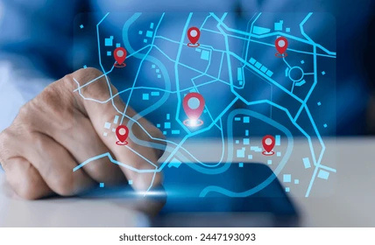
SYNTAX SQUAD
Smart India Hackathon 2025
Real-Time Public Transport Tracking
Keerthan | Sreeram | Rohith | Aasima | Likhitha | Srilatha

Slide 2



Current Challenges in Public Transport
01
Traffic Congestion
Small cities face overwhelming traffic congestion, causing delays and frustration for commuters.
02
Lack of Tracking
The absence of real-time tracking contributes to uncertainty, leading to increased waiting times for passengers.
03
Inefficient Routes
Public transport often operates on inefficient routes, wasting time and resources, making the system less reliable.

Slide 3
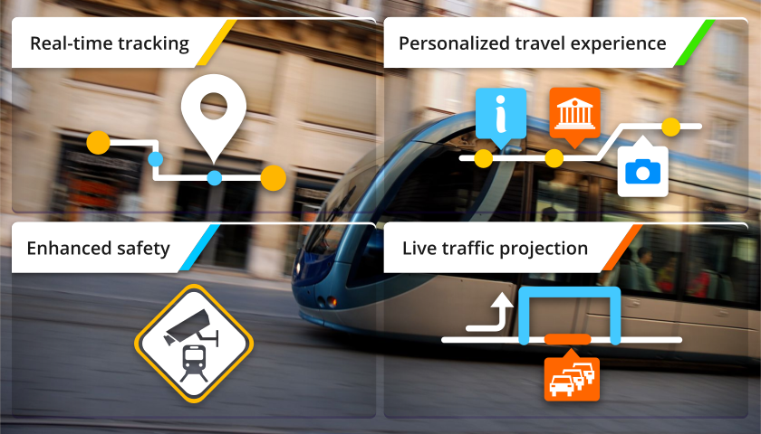
Objectives of Real-Time Tracking
01
Enhanced Efficiency
Streamlined operations through real-time data allows for better management of transport schedules and resources.
02
Increased User Satisfaction
Passengers benefit from accurate arrival times, reducing wait times and enhancing their overall travel experience.
03
Improved Safety
Real-time tracking ensures safety measures are in place, allowing passengers to feel secure while using public transport.

Slide 4
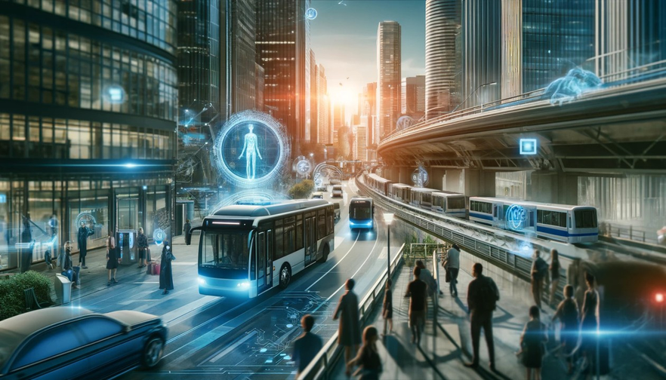
Proposed Solution Overview
01
Real-Time Tracking
Users can monitor bus locations and receive instant updates on arrival times, ensuring efficient travel planning.
02
User-Friendly Interface
The mobile/web app provides a seamless experience for passengers, allowing easy navigation and access to transport information.
03
GPS-Enabled Buses
Buses equipped with GPS technology guarantee accurate tracking, improving service reliability and increasing passenger trust.

Slide 5
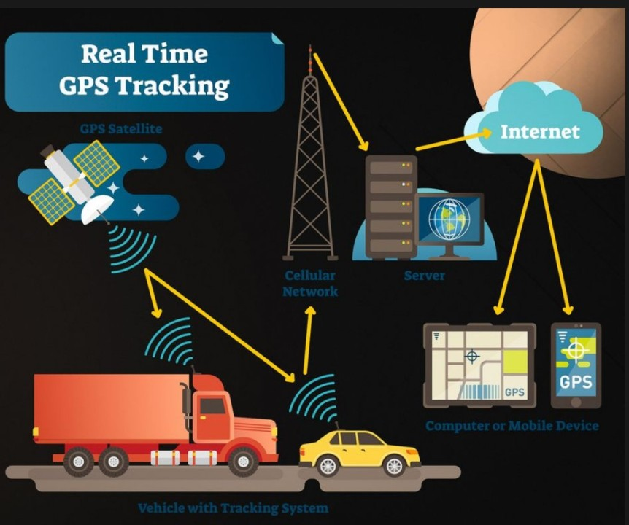
Key Features of Our Solution
Our real-time tracking system offers multiple innovative features for users.
Real-time tracking of buses
Accurate Estimated Time of Arrival (ETA)
Optimized routes for efficiency
User-friendly mobile/web dashboard

Slide 6

GPS DEVICES
CLOUD SERVER
Buses are equipped with GPS devices for real-time location tracking.
Data from GPS devices is sent to a cloud server for processing.
MOBILE/WEB INTERFACE
USER NOTIFICATIONS
Users access the system through a mobile or web interface for updates.
Passengers receive real-time alerts and updates on their transportation status.

Slide 7
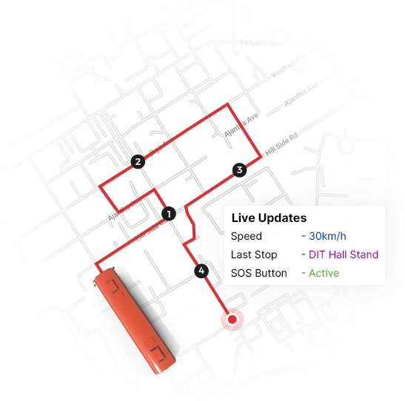
Technology Stack Overview
01
Backend Technology
Utilizing robust frameworks and languages like Node.js for efficient server-side processing and data management.
02
Frontend Framework
Implementing modern frameworks such as React for a dynamic user interface that enhances user experience.
03
Database Management
Leveraging cloud-based databases like MongoDB for scalable and secure data storage, ensuring real-time access.

Slide 8
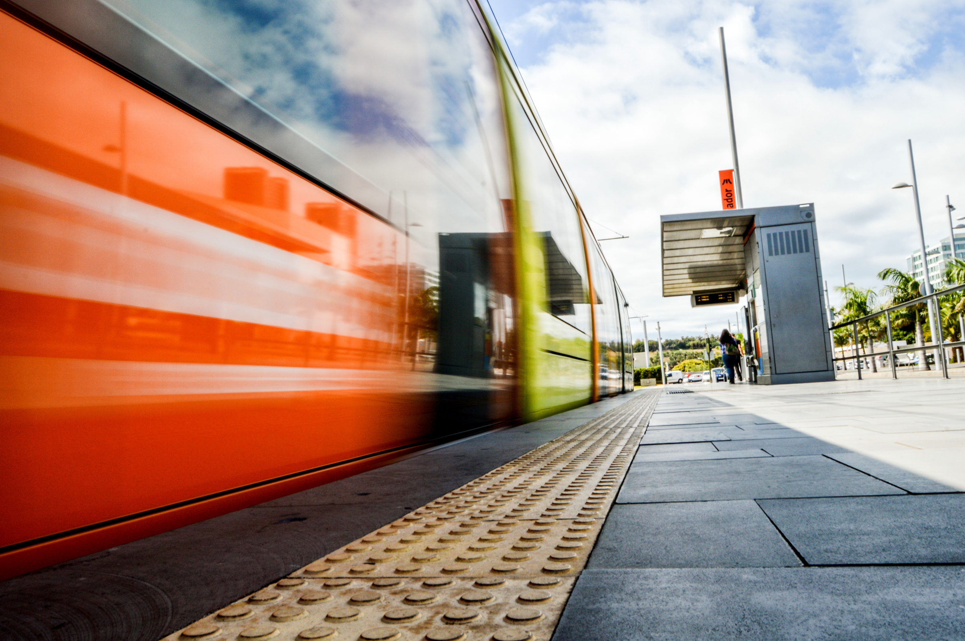
Implementation Plan Overview
01
Development Phase
Initial development involves creating the software architecture and integrating necessary technologies for the tracking system.
02
Deployment Phase
The deployment will involve setting up the infrastructure, including GPS devices in buses and cloud servers for data management.
03
Pilot Testing
Conducting pilot tests in select small cities will help validate system effectiveness and gather user feedback for improvements.

Slide 9

Benefits of Real-Time Tracking
01
Enhanced Safety for Passengers
Real-time tracking provides immediate updates on bus locations, ensuring passengers feel secure while waiting.
02
Improved Efficiency for Authorities
Authorities can monitor bus performance, leading to better resource allocation and quicker response to issues.
03
Positive Societal Impacts
A more reliable public transport system encourages sustainable commuting, reducing traffic congestion and pollution.

Slide 10
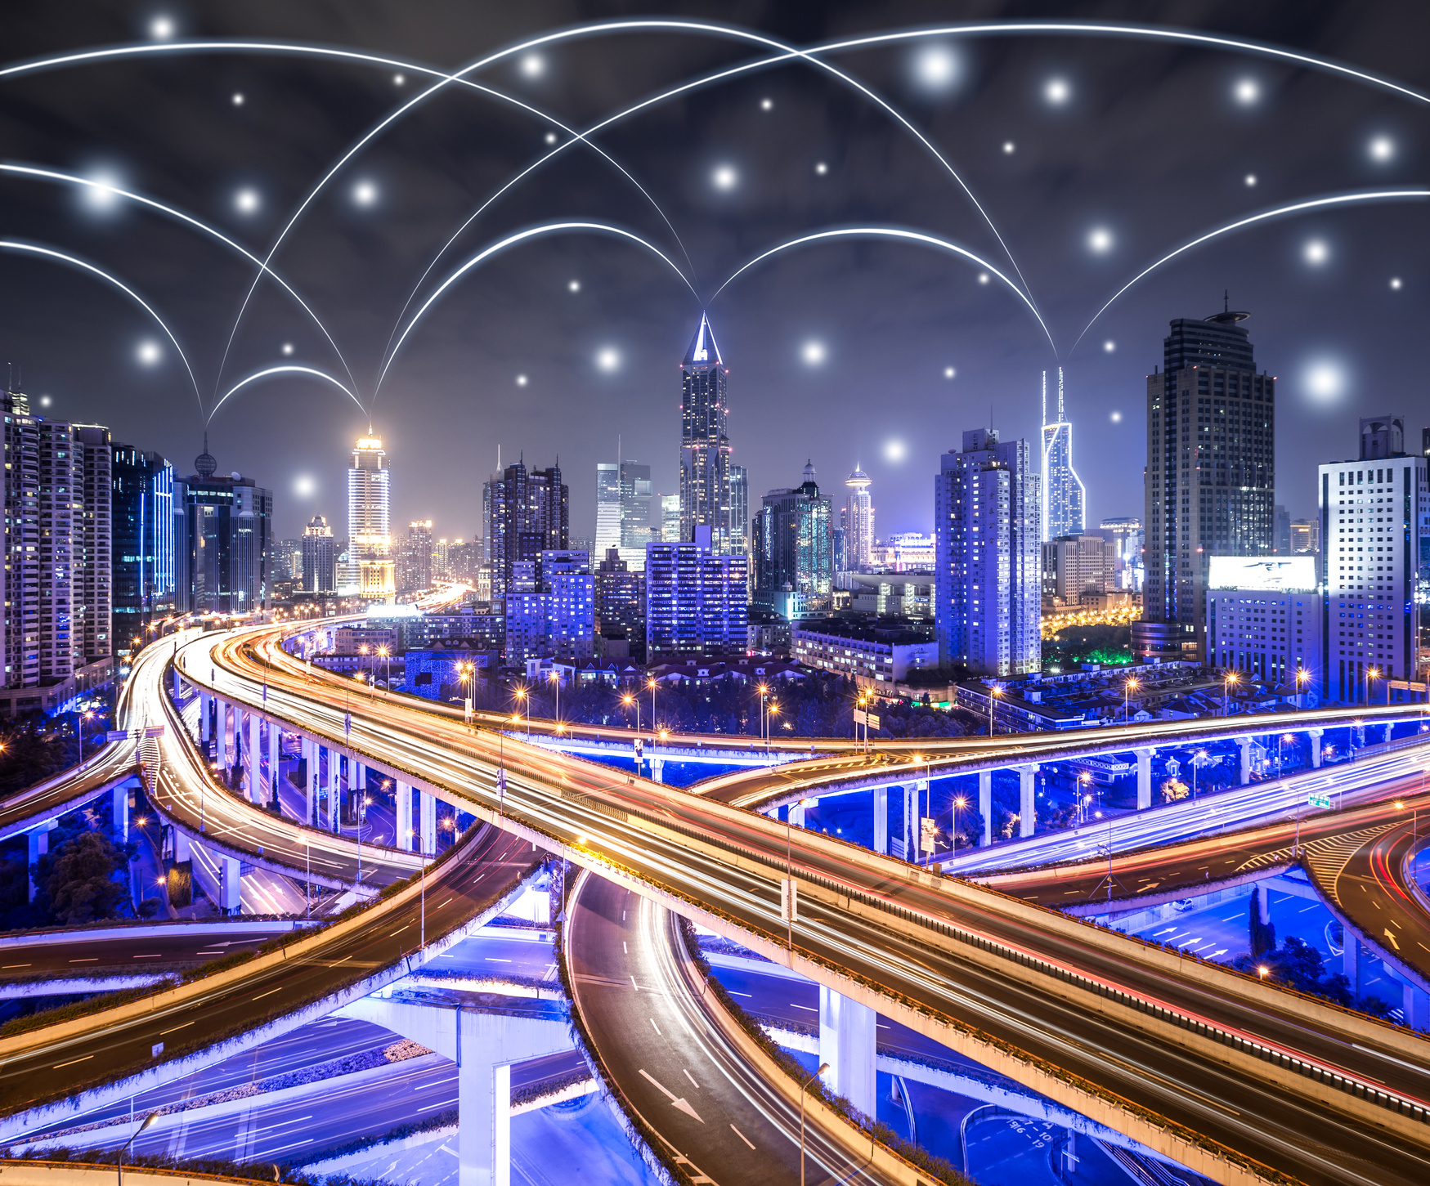
Market Potential & Scalability
01
Adoption in Other Cities
The real-time tracking system can be easily implemented in various small cities, enhancing public transport accessibility and efficiency.
02
Integration with Smart City Initiatives
This solution aligns with smart city frameworks, promoting sustainable urban development and improving transport infrastructure.
03
Expanding Solutions for Better Public Transport
Additional features can be developed to address specific local needs, ensuring a tailored approach to public transport challenges.

Slide 11

Challenges and Risk Mitigation
01
Internet Connectivity Issues
Implementing offline capabilities ensures service continuity during connectivity lapses.
02
Managing Device Cost
Utilizing affordable IoT devices minimizes initial investment while maintaining quality.
03
Ensuring Scalability
Designing a modular architecture allows easy expansion to accommodate growing user demands.

Slide 12
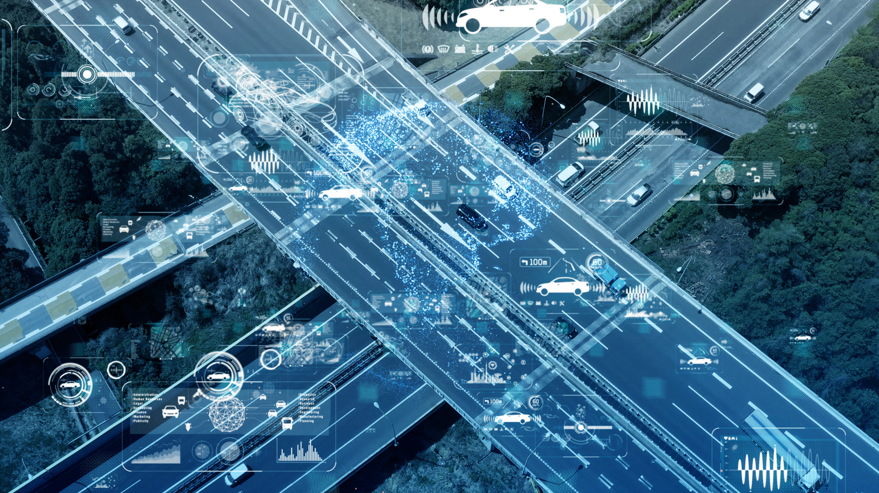
Future Enhancements
01
AI for Predictive Analytics
Incorporating AI will enable data-driven insights, allowing for improved demand forecasting and operational efficiency in real-time public transport.
02
Smart Ticketing Solutions
Implementing smart ticketing will streamline the payment process, making it easier for passengers to access transport services using digital transactions.
03
Integration with EV Infrastructure
Aligning with electric vehicle infrastructure will promote sustainable transport, enabling eco-friendly public transport options and reducing carbon emissions.

Slide 13

Frontend developed and deployed with user-friendly dashboards, training modules, and real-time alert screens.”

Slide 14
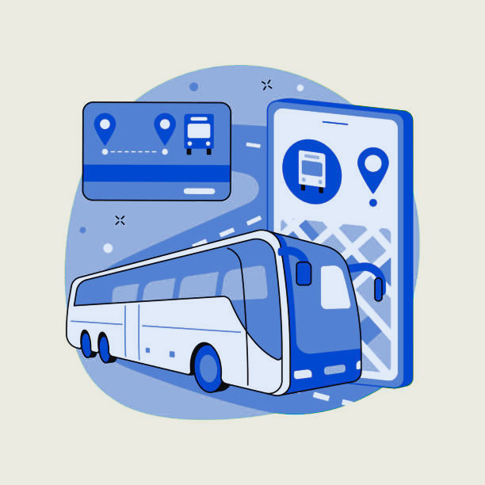
Conclusion & Impact
01
Enhanced Accessibility
Improved public transport systems will provide greater access for all citizens, ensuring that everyone can reach essential services and jobs.
02
Increased Efficiency
Real-time tracking will reduce waiting times and optimize routes, making transportation more reliable and efficient for passengers.
03
Economic Growth
A well-functioning public transport system can boost local economies by attracting businesses and encouraging tourism in small cities.

Slide 15
Thank you for your attention and support!
CONNECT WITH US FOR MORE INFORMATION AND UPDATES!
CSE(AI & ML)
LBRCE
MYLAVARAM

